Slide 1
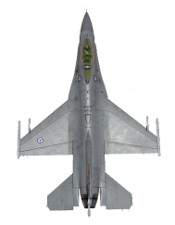
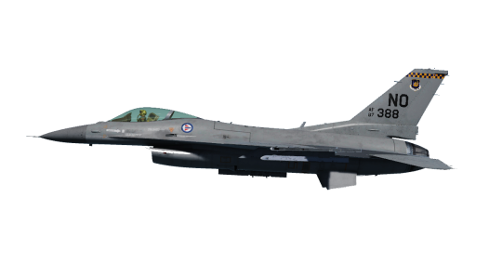
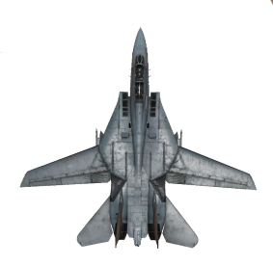
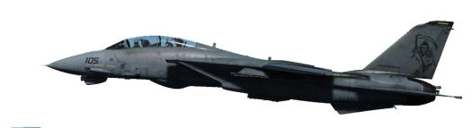
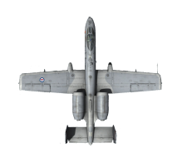

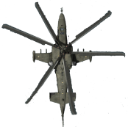


Slide 2

FAC(A) Overhead holding pattern
FAC(A)
CAS flight
Target

Slide 3
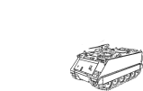

FAC(A) Side holding pattern
Target
CAS flight
Forward Line of Own Troops (FLOT)
FAC(A)
Friendly position

Slide 4
FAC(A) Figure 8 Pattern
FAC(A)
Target
CAS flight

Slide 5
FAC(A) Wheel
FAC(A)
CAS flight
Target

Slide 6
Racetrack pattern
ABEAM
OUTBOUND
INBOUND
FIX

Slide 7
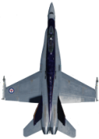
Figure Eight Pattern
FIX

Slide 8
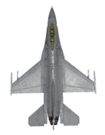
Wheel orbit
FIX

Slide 9
Offset example
õ
Enemy air defense target
Target
CAS flight
Gun-target-line
IP-target line
OFFSET RIGHT
#
Friendly artillery
Initial Point (IP)

Slide 10
Example of Attack Helicopter Control Points
Target
Heading/distance
Holding area(HA)
Ingress route
=
Firing point (FP)
Battle Position (BP)

Slide 11
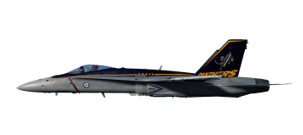
Level – medium
Level - lowlevel
Dive
Toss/loft
Pop up
Medium altitude – Level delivery

Slide 12
Level – medium
Level - lowlevel
Dive
Toss/loft
Pop up
Low altitude – Level delivery

Slide 13
Level – medium
Level - lowlevel
Dive
Toss/loft
Pop up
Medium altitude – dive delivery

Slide 14
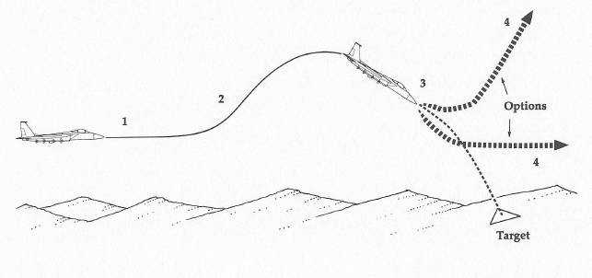
Level – medium
Level - lowlevel
Dive
Toss/loft
Pop up
Medium altitude – dive toss delivery
Target

Slide 15
Level – medium
Level - lowlevel
Dive
Toss/loft
Pop up
Low altitude – Toss/loft delivery

Slide 16
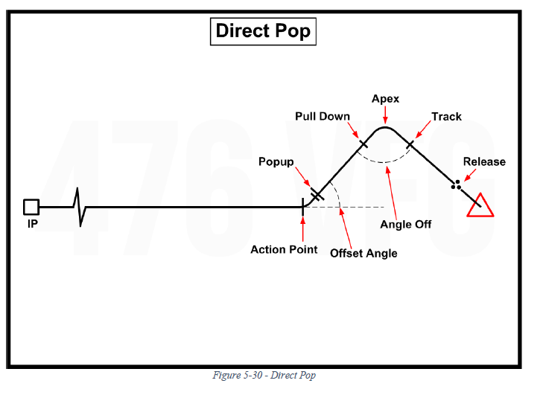
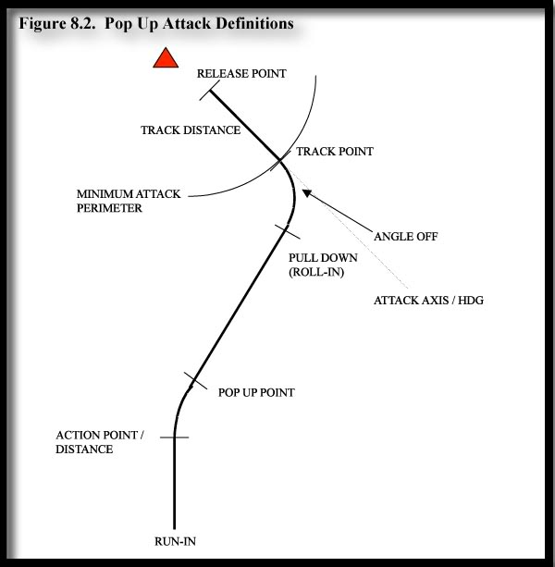
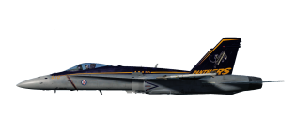
Level – medium
Level - lowlevel
Dive
Toss/loft
Pop up
Low altitude – pop-up delivery (horizontal view)
Apex
Pull down / Roll-in
Pop-up angle
Action point
Pop-up point

Slide 17
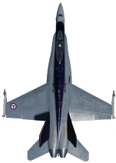
Level – medium
Level - lowlevel
Dive
Toss/loft
Pop up
Low altitude – pop-up delivery (vertical view)
Apex
Offset angle
Pull down / Roll-in
Pop-up point
Action point

Slide 18
Level – medium
Level - lowlevel
Dive
Toss/loft
Pop up
Low altitude – dive delivery
Target

Slide 19
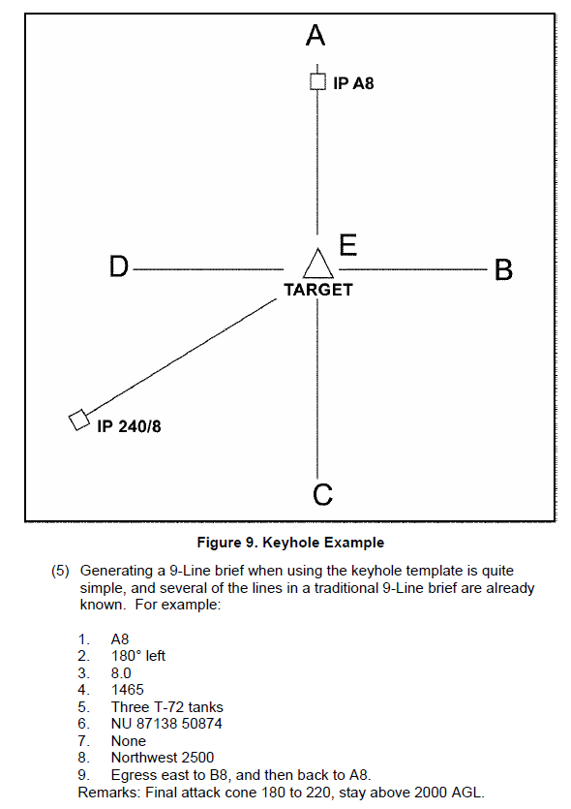
Keyhole example
A
IP 325/7
E
IP B7
D
B
Target
C

Slide 20

High-Low-High (HI-LO-HI)
 | Egress | Target area | Ingress
High
Low
High-High-High (HI-HI-HI)
 | Egress | Target area | Ingress
High
Low
High-Low-Low (HI-LO-LO)
 | Egress | Target area | Ingress
High
Low

Slide 21

Low-Low-High (LO-LO-HI)
 | Egress | Target area | Ingress
High
Low
Low-Low-Low (LO-LO-LO)
 | Egress | Target area | Ingress
High
Low

Slide 22
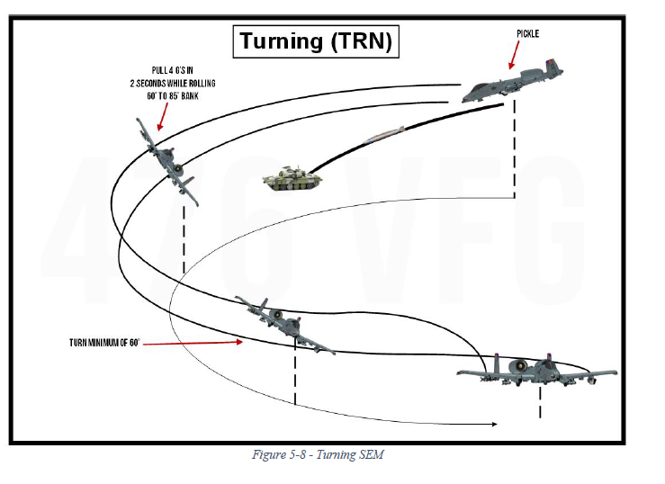

Slide 23
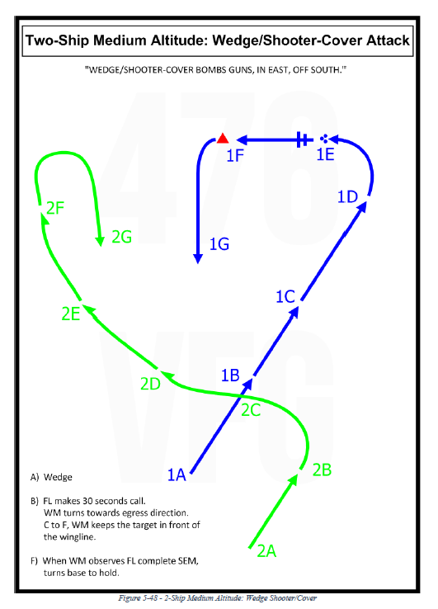

Two-Ship High/Medium Altitude: Wedge / Shooter-Cover
A: Both FL and WM are in a WEDGE formation.
B: FL makes 30 second call, WM turns toward attack direction.
C: WM keep the target in front of the wingline through F.
D: FL start tipping in to target.
E: FL on final to target.
F: When WM observes FL complete SEM, WM turn to egress direction to rejoin in WEDGE with FL.
2F
1F
1E
2G
1D
1G
2E
1C
2D
1B
2C
1A
2B
2A

Slide 24
Two-Ship High/Medium Altitude: Wedge / Shooter-Cover
A: Both FL and WM are in a WEDGE formation.
B: FL makes 30 second call, WM turns toward attack direction.
C: WM keep the target in front of the wingline through F.
D: FL start tipping in to target.
E: FL on final to target.
F: When WM observes FL complete SEM, WM turn to egress direction to rejoin in WEDGE with FL.
2F
1F
1E
2G
1D
1G
2E
1C
2D
1B
2C
1A
2B
2A

Slide 25
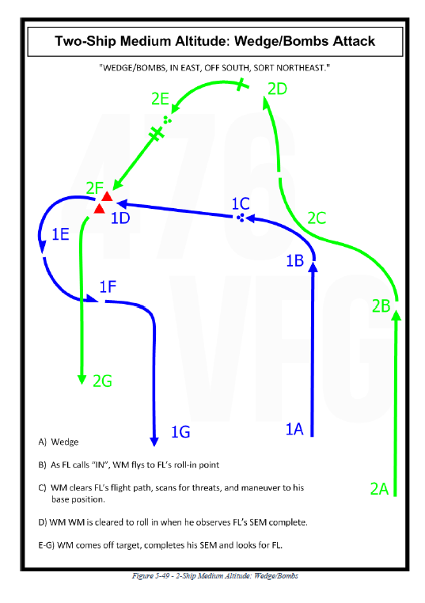
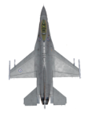
Two-Ship High/Medium Altitude: Wedge / Shooter-Shooter
A: Both FL and WM are in a WEDGE formation.
B: FL calls ”IN” , WM flys to FL’s roll-in point.
C: WM clears FL’s flightpath, scan for threats and maneuver to base position,
C: FL On final.
D: WM is cleared to roll in when he observes FL’s SEM completion,
E: WM on final to target.
E: FL clears WM’s flightpath, scan for threats and maneuver for egress.
F-G: Egresss and rejoin in WEDGE formation
2E
2D
2F
1D
2C
1C
1E
2B
1B
1F
1A
2A
2G
1G

Slide 26
A: Both FL and WM are in a WEDGE formation.
B: FL calls ”IN” , WM flys to FL’s roll-in point.
C: WM clears FL’s flightpath, scan for threats and maneuver to base position,
C: FL On final.
D: WM is cleared to roll in when he observes FL’s SEM completion,
E: WM on final to target.
E: FL clears WM’s flightpath, scan for threats and maneuver for egress.
F-G: Egresss and rejoin in WEDGE formation
Two-Ship High/Medium Altitude: Wedge / Shooter-Shooter
2E
2D
2F
1D
2C
1C
1E
2B
1B
1F
1A
2A
2G
1G
IP

Slide 27
Two-Ship High/Medium Altitude: Wedge / Shooter-Shooter
A: Both FL and WM are in a WEDGE formation.
B: FL calls ”IN” , WM flys to FL’s roll-in point.
C: WM clears FL’s flightpath, scan for threats and maneuver to base position,
C: FL On final.
D: WM is cleared to roll in when he observes FL’s SEM completion,
E: WM on final to target.
E: FL clears WM’s flightpath, scan for threats and maneuver for egress.
F-G: Egresss and rejoin in WEDGE formation
2E
2D
2F
1D
2C
1C
1E
2B
1B
1F
1A
2A
2G
1G

Slide 28
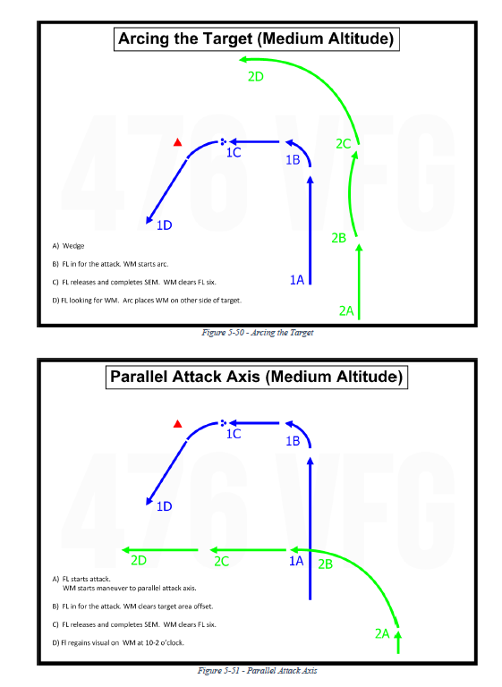
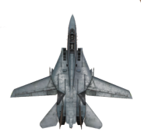
Parallel Attack Axis
A: Both FL and WM are in a WEDGE formation.
FL starts attack. WM maneuver to parallel attack axis
B: FL tips in for the attack. WM clears target area.
C: Fl releases and completes SEM. WM clear FL six.
D: FL regains visual on WM at 10-2 o’clock
1C
1B
1D
2D
2C
1A
2B
1E
2A
1F
2G
1G

Slide 29
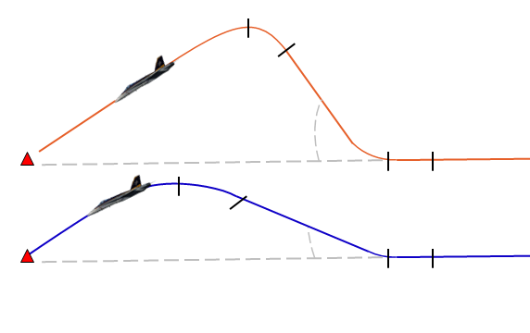
Two-Ship Low Altitude Pop-up/ Shooter-Shooter
1G
FL Conducting a 10˚ LAHD using MK82 High drag
WM conducting a 30˚ HADB using MK82 Low drag
A: Both FL and WM are in a WEDGE formation.
B: FL calls ”ACTION” , and intiate turn and cpop-up. WM continue until own action point for turn and pop-up.
C: Pull-down and
D: Highest altitude (APEX)
E: On final, tracking target
F: Releasing weapons
G: Turn to reverse course back to IP
H: Reaquire visual
I: Back in WEDGE formation.
1F
2G
2F
2H
1E
1H
2E
1D
2I
2D
1I
1C
2C
2D
2C
1B
2B
2B
1D
1C
1B
1A
2A

Slide 30
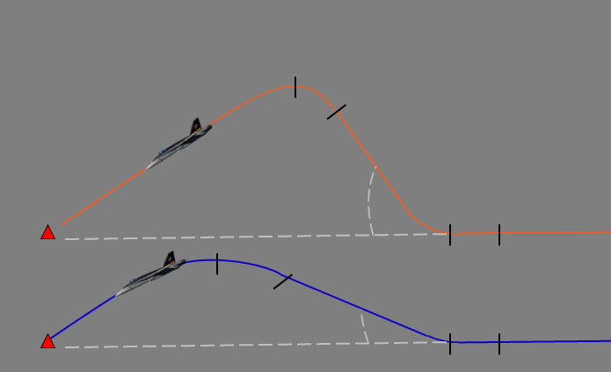
Two-Ship Low Altitude Pop-up/ Shooter-Shooter
1G
FL Conducting a 10˚ LAHD using MK82 High drag
WM conducting a 30˚ HADB using MK82 Low drag
A: Both FL and WM are in a WEDGE formation.
B: FL calls ”ACTION” , and intiate turn and cpop-up. WM continue until own action point for turn and pop-up.
C: Pull-down and
D: Highest altitude (APEX)
E: On final, tracking target
F: Releasing weapons
G: Turn to reverse course back to IP
H: Reaquire visual
I: Back in WEDGE formation.
1F
2G
2F
2H
1E
1H
2E
1D
2I
2D
1I
1C
2C
2D
2C
1B
2B
2B
1D
1C
1B
1A
2A

Slide 31
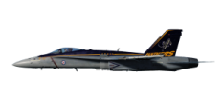
Level – medium
Level - lowlevel
Dive
Toss/loft
Pop up
Low altitude – pop-up delivery (horizontal view)

Slide 32
Level – medium
Level - lowlevel
Dive
Toss/loft
Pop up
Low altitude – pop-up delivery (horizontal view)

Slide 33
Two-Ship Low Altitude: Line abreast, Maverick Attack / Shooter-Shooter
A: Both FL and WM are in a Line abreast formation.
B: Flight climb and unmask.
C: Flight rifles and conducts a hook turn to either left or right while diving back to mask by terrain.
D: Flight egresses
2D
2C
1D
1C
2B
1B
1E
2A
1A
1F
2G
1G

Slide 34
Two-Ship High/Medium Altitude: Line abreast, Standoff Attack / Shooter-Shooter
A: Both FL and WM are in a Line abreast formation.
B: Flight launches standoff weapons (Maverick / JSOW) and conducts a hook turn to either left or right.
C: Flight egresses.
2C
2B
1C
1B
1E
2A
1A
1F
2G
1G

Slide 36
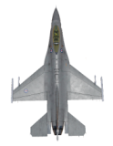
Ground lased delivery
10-60°
C
Ground laser
B
A
A: Pilot releases his weapon and turns away
B: Pilot call «10 seconds» when it is 10 seconds until the ground laser should be started. This serves as a heads up call to the laser operator that in 10 seconds he will get a laser on call.
C: Pilot call «Laser on» when ground laser should be started. Ground laser then replies with «lasing» and have a continous lasing at the target until bomb impact or pilot call «cease laser» as a signal to stop lasing.
NOTE: Attacks should only be made within a 10°- 60° cone on either left or right side of the ground laser.

Slide 37
